Slide 1

Elasticities of Demand
2.5

Slide 2

Discuss the law of demand with your partner.
What does it mean and is it true for all goods and services?

Slide 3



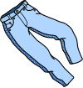

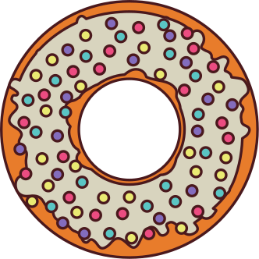
If the price goes up significantly for these products, what will happen to their quantity demanded?

Slide 4

Definitions
Goods and services are not all created equal. Some goods are very sensitive in price change while others seem to be unaffected.
Elasticity - The responsiveness of one variable to a change in another variable

Slide 5
Definitions
Elasticity of Demand - a measure of the responsiveness of the quantity demanded of a good or service to changes in one of the factors that determine it.
Price Elasticity of Demand (PED) - a measure of how much the quantity demanded of a good changes when there is a change in its own price.

Slide 6

Formulas
The extent to which the quantity demanded changes depends on how 'elastic' its demand is with respect to its price.
% change in quantity demanded of good x
PED =
% change in price of good x
ALSO WRITTEN AS
%△Qd
%△P
PED =

Slide 7
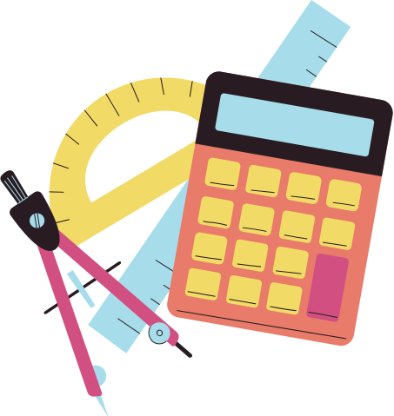
Formulas
new - old
% change =
x 100
old

Slide 8
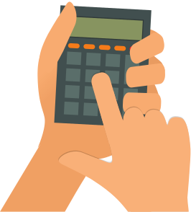
Try It Out - PED
The price of train tickets decline by 10 per cent and, as a result, the quantity demanded of train tickets increases by 15 per cent
What is the PED?

Slide 9
Try It Out
PED = - 1.5
Due to inverse relationship of price and quantity demanded, PED will always be negative. However, economists typically write this in absolute value form as positive.
PED = 1.5
This means . . for every 1per cent decrease in the price of train tickets, the quantity demanded of train tickets increases 1.5per cent.

Slide 10
Try It Out - % Change
1. Price increased from $40 to $50.
2. Quantity fell to 12 from 18
3. Price decreased from $600 to $540
4. Quantity increased from 300 to 360
5. Price increased from $80 to $140.

Slide 11
Try It Out - % Change
1. +25%
2. -33%
3. -10%
4. +20%
5. +75%

Slide 12
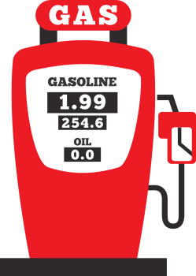

Inelastic vs Elastic
Inelastic Goods
INsensitive to changes in price
Price Inlastic Demand
A situation where the percentage change in the quantity of a good or service is less than the percentage change in its price.
Elastic Goods
Sensitive to changes in price
Price Elastic Demand
A situation where the percentage change in the quantity of a good or service is greater than the percentage change in its price.
Copyright Bananaomics

Slide 13

Inelastic
General Characteristics of INelastic Goods:
  Few Close Substitutes
  High Degree of necessity
  Small portion of income
  Addictive
  Required now, rather than later (Time)
  Elasticity coefficient less than 1
Copyright Bananaomics

Slide 14
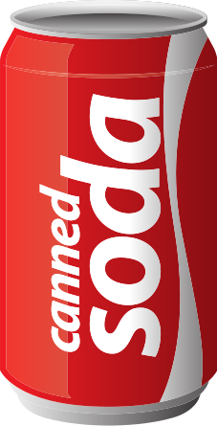

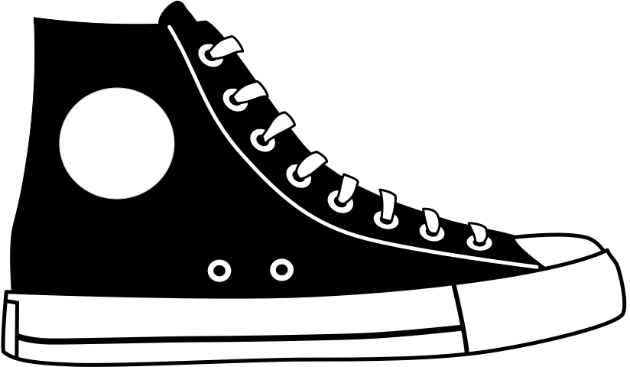
Elastic
General Characteristics of Elastic Goods:
  Many Substitutes
  Luxury Goods
  Large portion of income
  Non-Addictive
  Plenty of time to decide, not urgent
  Elasticity coefficient greater than 1
Copyright Bananaomics

Slide 15
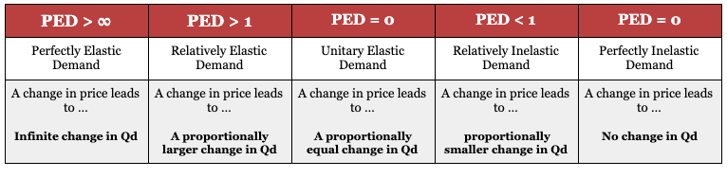
PED
We use PED, to determine if demand for a good is elastic or inelastic.
Copyright Bananaomics

Slide 16

Drawing Inelastic and Elastic Demand
Copyright Bananaomics

Slide 17
What do you think a demand curve looks like for a product with:
elastic demand? inelastic demand?
Brainstorm with your partner with your knowledge of supply and demand
Copyright Bananaomics

Slide 18
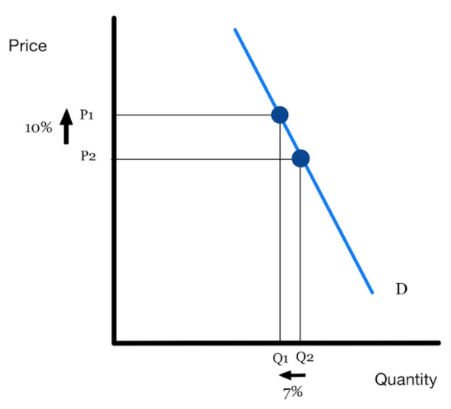
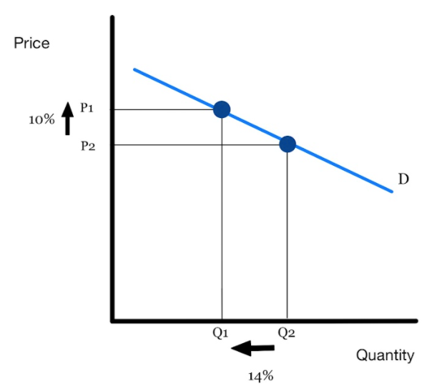
Inelastic vs Elastic
Inelastic Goods
INsensitive to changes in price.
Looks like an "I" - vertical
Elastic Goods
Sensitive to changes in price
Looks flatter!
Copyright Bananaomics

Slide 19
PED > 1
Relatively Elastic
Copyright Bananaomics

Slide 20
PED = 0-1
Relatively Inelastic
Copyright Bananaomics

Slide 21
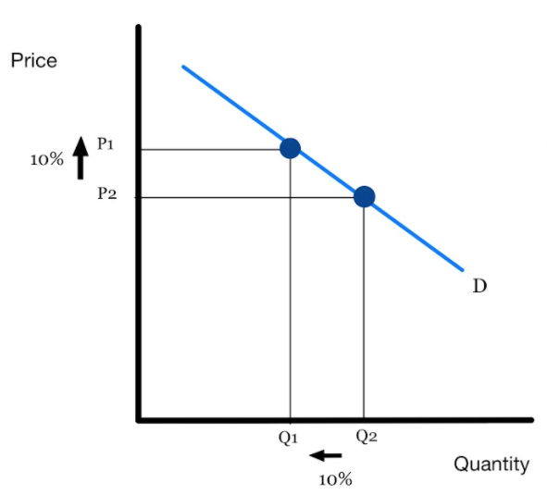
PED = 1
Unit or Unitary Elastic
Copyright Bananaomics

Slide 22
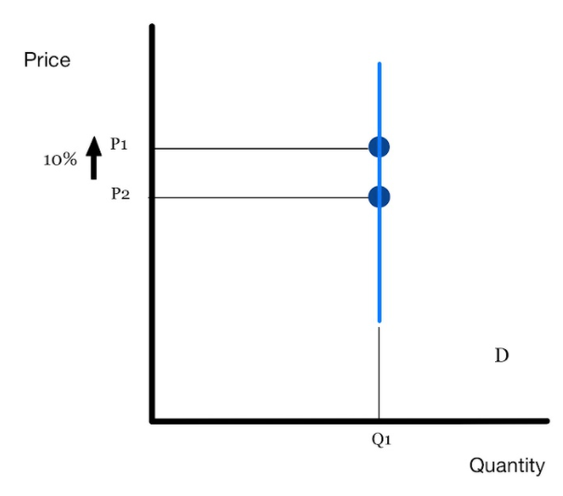

PED = 0
Perfectly Inelastic
Copyright Bananaomics

Slide 23

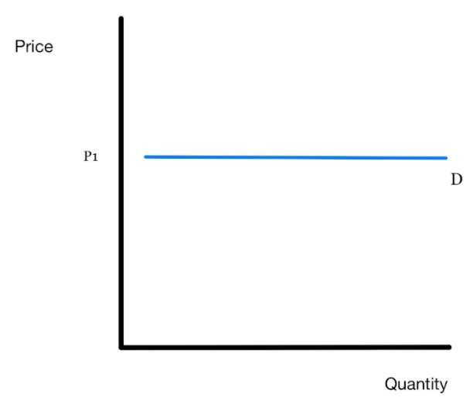
PED =
Perfectly Elastic
Copyright Bananaomics

Slide 24
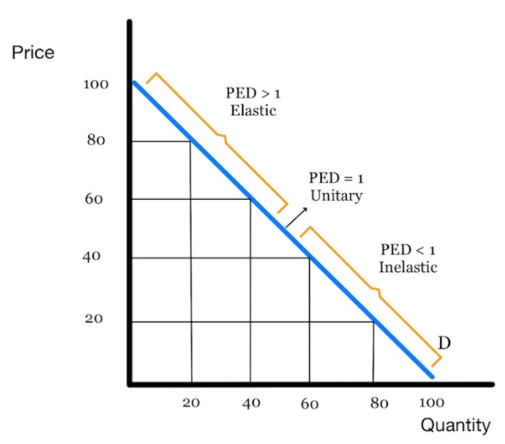
PED
PED changes from point to point along a demand curve
Copyright Chandler Bell

Slide 25
PED Examples
Lettuce-
Gasoline-
Apartment-
Medical Care-
Electricity-
Diamond-
Elastic -1.27
INelastic -.20
Elastic -1.60
INelastic -.31
INelastic -.13
Elastic -2.6
Copyright Chandler Bell

Slide 26

PED
1. The price of phones increase by 10% and QD decreases by 50%.
2. The price of band-aids increases from $2 to $3 and QD decreases by 10%.
3. The price of gasoline increases from $2 to $4 and QD decreases by 1%.
4. The price of hamburgers increases from $1 to $1.25 and QD decreases by 25%.
Copyright Chandler Bell

Slide 27
PED
1. The price of hats increase by 10% and QD decreases by 50%.
2. The price of water increases from $2 to $3 and QD decreases by 10%.
3. The price of gasoline increases from $2 to $4 and QD decreases by 1%.
4. The price of gum increases from $1 to $1.25 and QD decreases by 25%.
  Elastic = 5
  Inelastic = 0.2
  Inelastic = 0.01
  Unit-elastic = 1
Copyright Chandler Bell

Slide 28
Another way to measure?
Total Revenue Test
How does elasticity affect Total Revenue?
If the demand for medicine is inelastic, what happens to TR for medicine stations if price increases?
Inelastic
Price - increase
TR - increase
Price - decrease
TR - decrease
Elastic
Price - increase
TR - decrease
Price - decrease
TR - increase
Unit Elastic
Price - increase/decrease
TR - no change
Copyright Chandler Bell

Slide 29
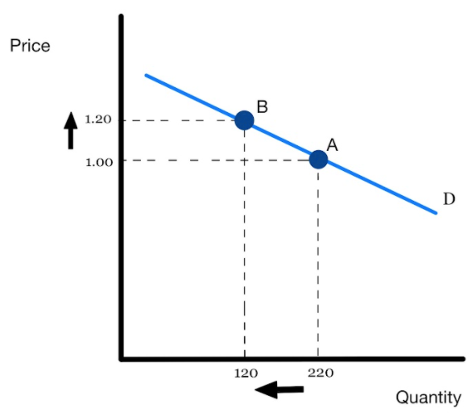
Total Revenue Test
What happens to TR when the price of this good increases from 1.00 to 1.20?
Is the demand for this good inelastic or elastic?
1 X 220 = 220
1.20 X 120 = 144
Copyright Chandler Bell

Slide 30
Total Revenue Test
The DEMAND FOR THIS GOOD is elastic. (Be sure to use correct wording)
- Don't say "This good is elastic"
Copyright Chandler Bell

Slide 31
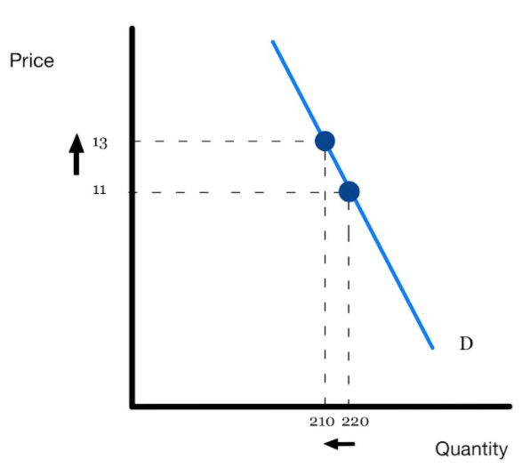
Total Revenue Test
What happens to TR when the price of this good increases from 11 to 13?
Is the demand for this good inelastic or elastic?
11 X 220 =2420
13 X 210 =2730
Copyright Chandler Bell

Slide 32
Total Revenue Test
The DEMAND FOR THIS GOOD is inelastic. (Be sure to use correct wording)
- Don't say "This good is inelastic"
Copyright Chandler Bell

Slide 33
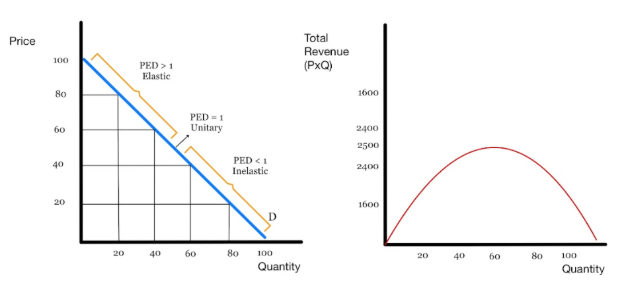
Total Revenue and PED
Copyright Chandler Bell

Slide 34


Slide 35

PED and Government Decisions
Taxes, Subsidies, and Surpluses
WISE CHOICES
Copyright Chandler Bell

Slide 36
Before we can understand tax burdens, we must understand what a consumer and producer surplus is
Copyright Chandler Bell

Slide 37
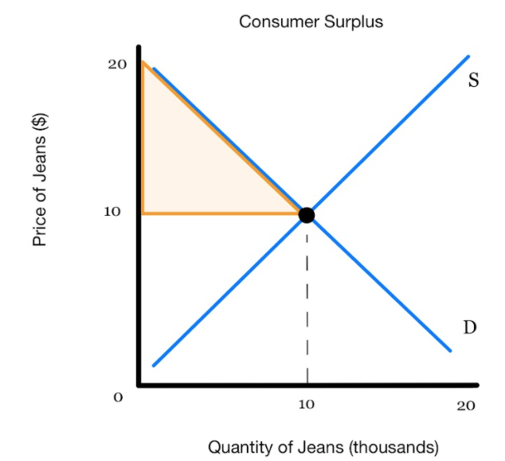
Consumer and Producer Surplus
Have you ever bought something for less than you were willing to pay?
For example, if you purchased a coffee at 1 Euro instead of the 2 Euro you were willing to spend.
The name for this is economics is CONSUMER SURPLUS - the difference between the highest price consumers are willing and able to pay for a good and the actual price they pay.
Copyright Chandler Bell

Slide 38
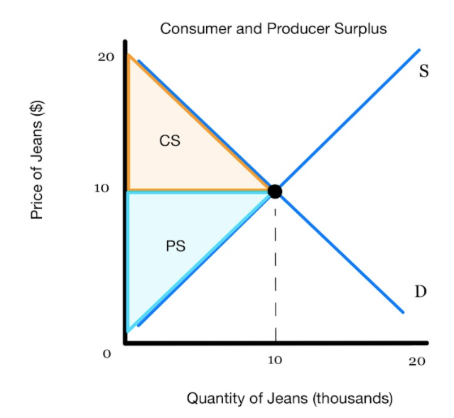
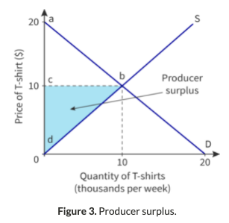
Consumer and Producer Surplus
This can also be true for producers.
Producer SURPLUS - the difference between the lowest price producers are willing and able to offer the good and the actual price that they receive for it.
Copyright Chandler Bell

Slide 39
Social/Community surplus
The sum of the consumer surplus and producer surplus. It is the total benefit gained by society when the market is at equilibrium..
Copyright Chandler Bell

Slide 40
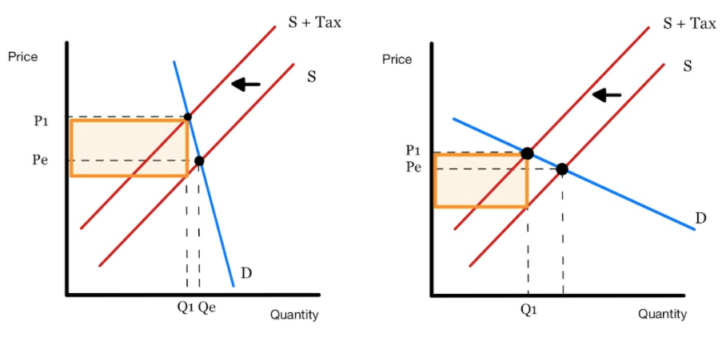
Taxes
Whose surplus do taxes take more of? Does it depend on the good?
Inelastic Demand (PED)
Elastic Demand (PED)
Copyright Chandler Bell

Slide 41
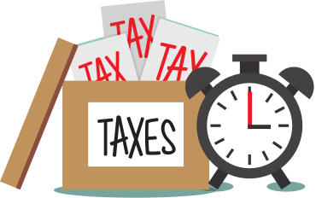
Taxes
Do you think governments tax goods with inelastic demand or elastic demand more? Why?
Copyright Chandler Bell

Slide 42
Taxes
Taxes on goods with INELASTIC demand, earn more revenue due to a change in price, changing Qd very little.
Copyright Chandler Bell

Slide 43

Income Elasticity of Demand(YED)
Copyright Chandler Bell

Slide 44
Definitions
A change in people's incomes causes an increase or decrease (a shift) in demand for a good. The extent to which the demand curve is shifted, and in which direction it will shift, is explained by the income elasticity of demand (YED) .
Income elasticity of demand (YED) - a measure of how much the quantity demanded of a good will change in response to a change in consumers' incomes.
Copyright Chandler Bell

Slide 45
Definitions
If Income rises by 5%, we will likely see an increase in Qd for many goods. HOWEVER, we will also see a drop in some at the same time.
YED tells us information regarding whether the good is a NORMAL or INFERIOR good
Copyright Chandler Bell

Slide 46
Formulas
The extent to which the quantity demanded changes depends on how 'elastic' its demand is with respect to its price.
% change in quantity demanded of good x
YED =
% change in income(Y)
ALSO WRITTEN AS
%△Qd
%△Y
YED =
Copyright Chandler Bell

Slide 47
YED
Income increases 20%, and quantity decreases 15% then the good is a…
Copyright Chandler Bell

Slide 48
YED
Income increases 20%, and quantity decreases 15% then the good is a(n)…
INFERIOR GOOD
Copyright Chandler Bell

Slide 49


YED
If coefficient is negative ( inverse relationship) then the good is inferior
If coefficient is positive ( direct relationship) then the good is normal
Copyright Chandler Bell

Slide 50
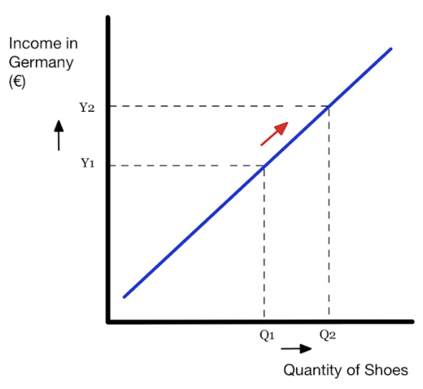
Engel Curve
To illustrate YED, we use an Engel Curve. An Engel Curve is used to show the relationship between income and quantity demanded.
Income is placed on the vertical axis
Quantity demanded on the horizontal axis.
Copyright Chandler Bell

Slide 51
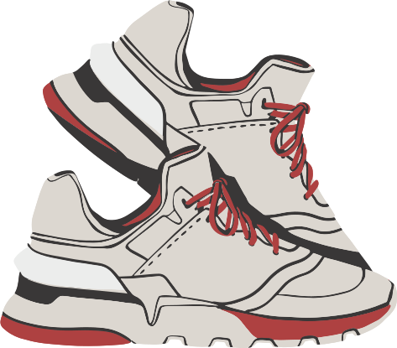
YED > 0
Normal Good
The Quantity Demanded of the good increases as consumer income increases. (Vice Versa)
Copyright Bananaomics

Slide 52
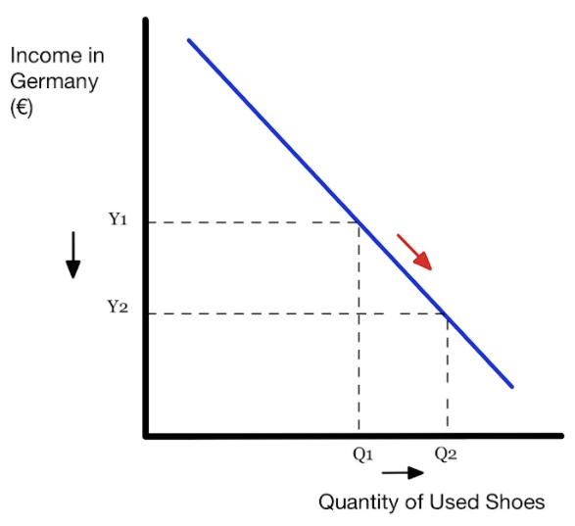

YED < 0
Inferior Good
The quantity demanded increases as consumer income decreases. (Vice Versa)
Copyright Chandler Bell

Slide 53
Additional Uses of YED
Copyright Chandler Bell

Slide 54
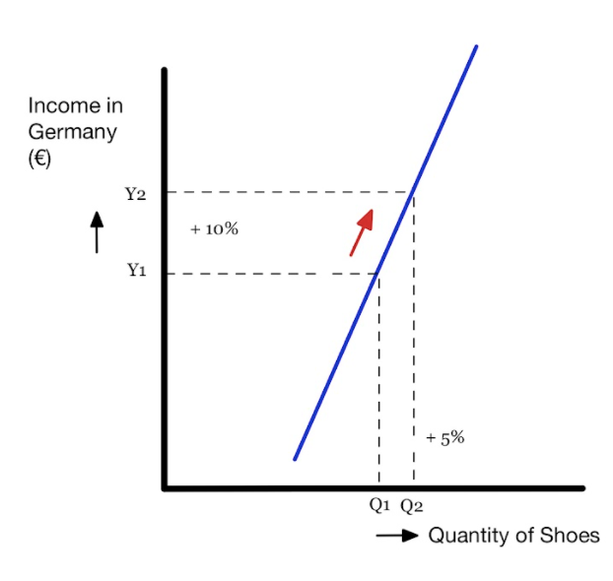
–1 < YED < 1
income inelastic demand (Necessity Good)
A change in income leads to . . .
a proportionally smaller change in quantity demanded.
Copyright Chandler Bell

Slide 55
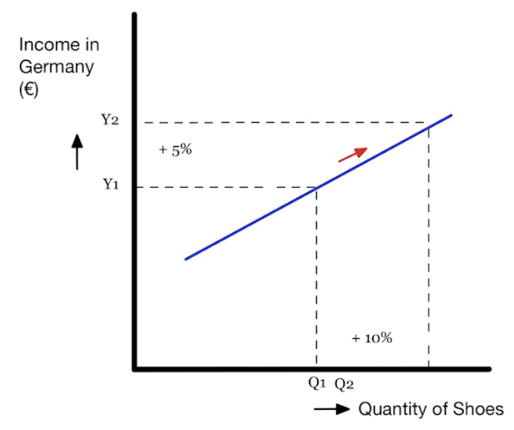
YED < –1, YED > 1
income elastic demand (Luxury Good)
A change in income leads to . . .
a proportionally greater change in quantity demanded.
Copyright Chandler Bell

Slide 56
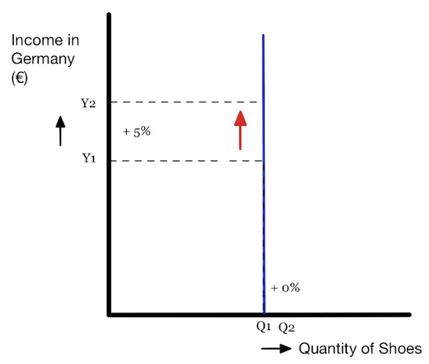
YED = 0
perfectly income inelastic demand (Necessity Good)
A change in income leads to . . .
no change in quantity demanded. The closer the YED is to zero, the greater the necessity.
Copyright Chandler Bell

Slide 57
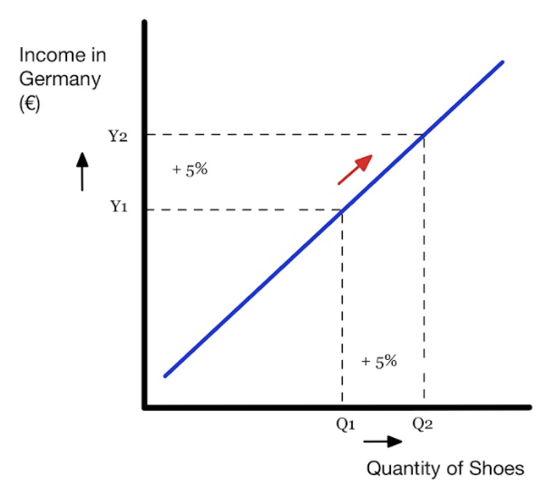
YED = 1
No Classification Term - Proportional Change
A change in income leads to . . .
a proportionally equal change in quantity demanded.
Copyright Chandler Bell

Slide 58

Global Citizenship
Not all countries experience Income Elasticity the same. Many areas of the world have different cultures, urbanization percentages, political factors, and income levels.
Example
Lower-income countries eat less meat due to its high general costs. Therefore, a change in income will likely greatly affect the quantity demanded of meat in a low-income country.
In contrast, high-income countries typically consume more meat and therefore, a change in income will likely have little/no affect on quantity demanded of meat.
Copyright Chandler Bell

Slide 59




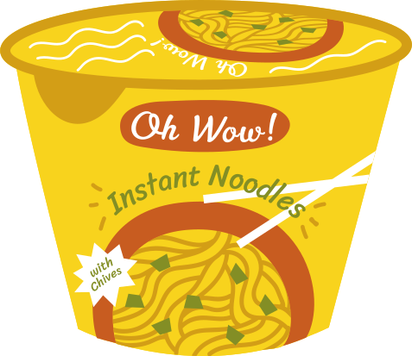
How would firms use YED in the real world?
Copyright Chandler Bell

Slide 60

Economic Growth and YED
In times of economic growth, incomes typically rise. During an economic decline, incomes typically fall.
Given the state of the economy, businesses who know their YED can determine if their product is an inferior or normal good and forecast sales and earnings.
Copyright Chandler Bell

Slide 61

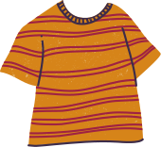










Income and Spending
As income-level changes over time, this can cause the entire output of an economy to shift to different sectors.. Consumers will change the way they spend larger portions of their income.
Copyright Chandler Bell

Slide 62

Sectors of an Economy
  Primary - primary commodities such as agriculture, mining, forestry.
  Secondary - goods produced from primary commodities such as clothes, cars, houses, books, paper.
  Tertiary - goods that are not yet tangible but improve quality of life such as entertainment, travel, healthcare, insurance, education.
Copyright Chandler Bell

Slide 63
Sectors of an Economy
As an economy grows over time, the relative size of these sectors, as a percentage of total output in the economy, changes.. This process is defined as Sectoral Change. Economists use YED to understand what an increase in income will do to each sector.
Copyright Chandler Bell

Slide 64

Practice Question
Copyright Bananaomics

Slide 65
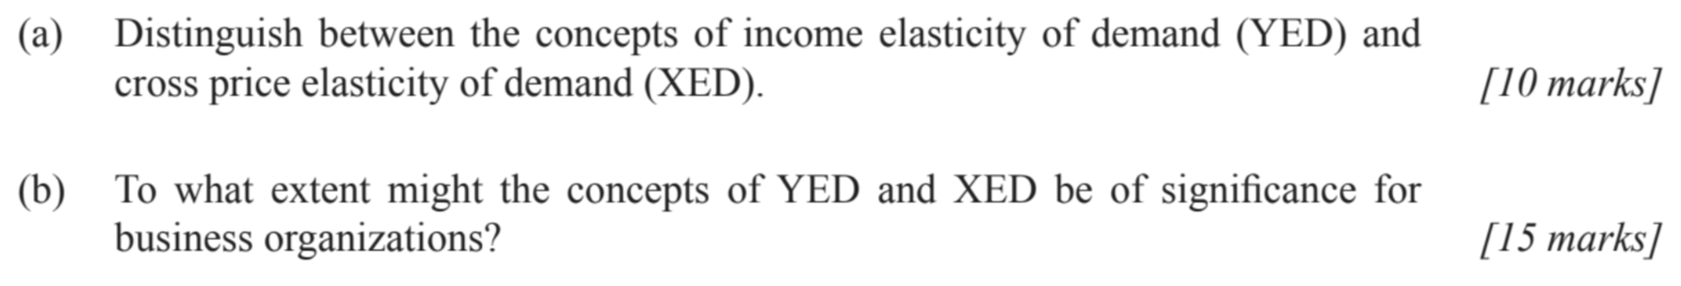
Paper 1 Part A
M14/3/ECONO/SP1/ENG/TZ2/XX
Copyright Bananaomics

Slide 66
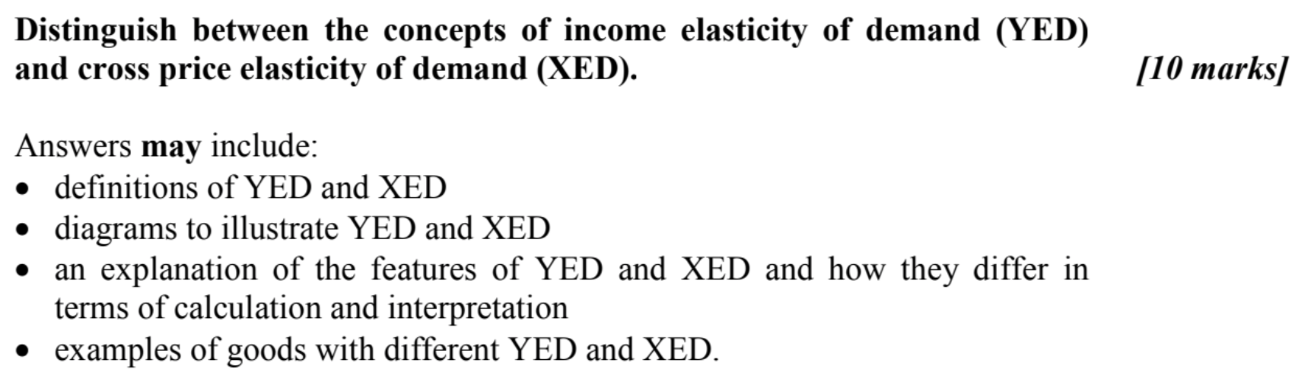
Check Answers
Copyright Bananaomics

Slide 67
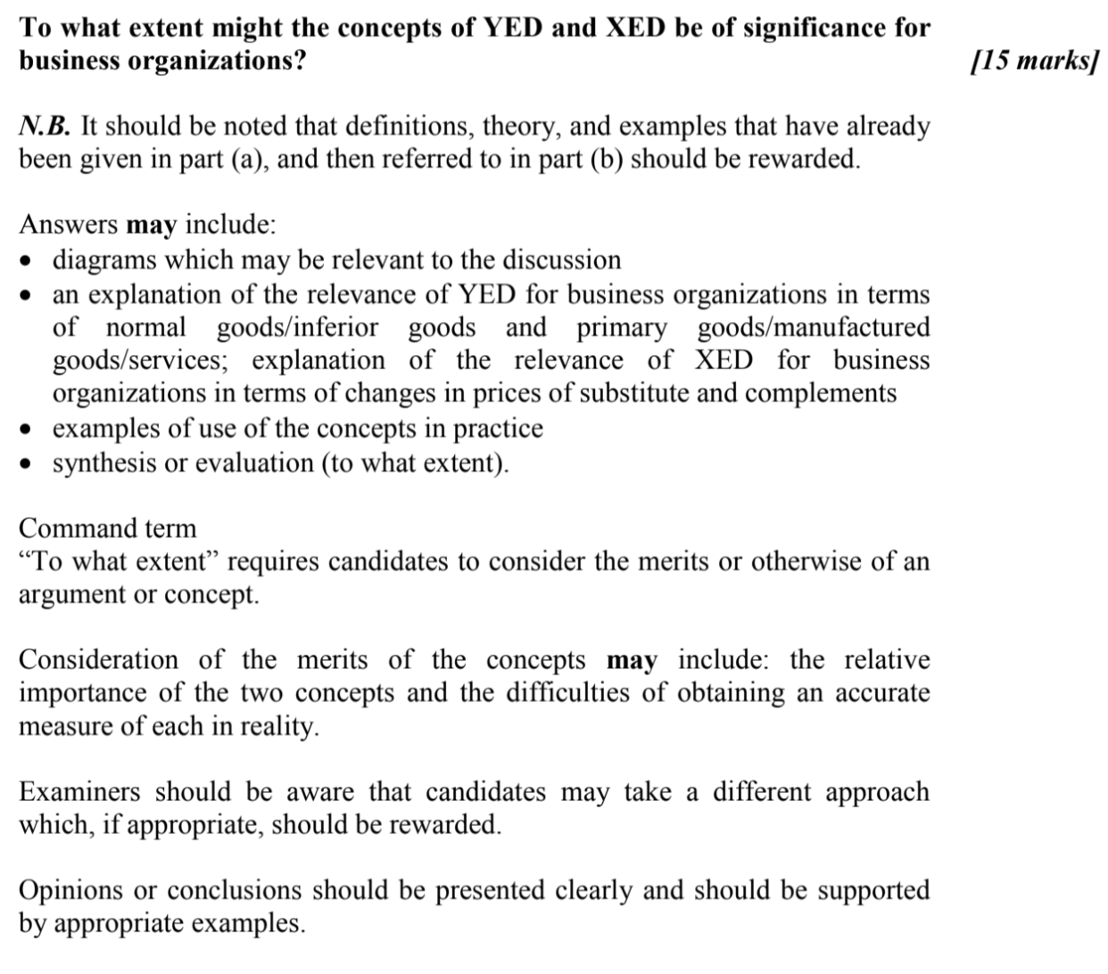
Check Answers
Copyright Bananaomics

Slide 68

Enjoying The Content?
Visit bananaomics.com to purchase package deals with discount prices!
BANANAOMICS

